Slide 1

Accessibility
A Samuel Pottinger
Stat 198: IDSV
April 15, 2025

Slide 2
Today
> Introduction
Visual Accessibility
Group Activity
Motor Accessibility
Additional Resources

Slide 3

Starting with games
Notes:
https://youtu.be/xrqdU4cZaLw?feature=shared

Slide 4
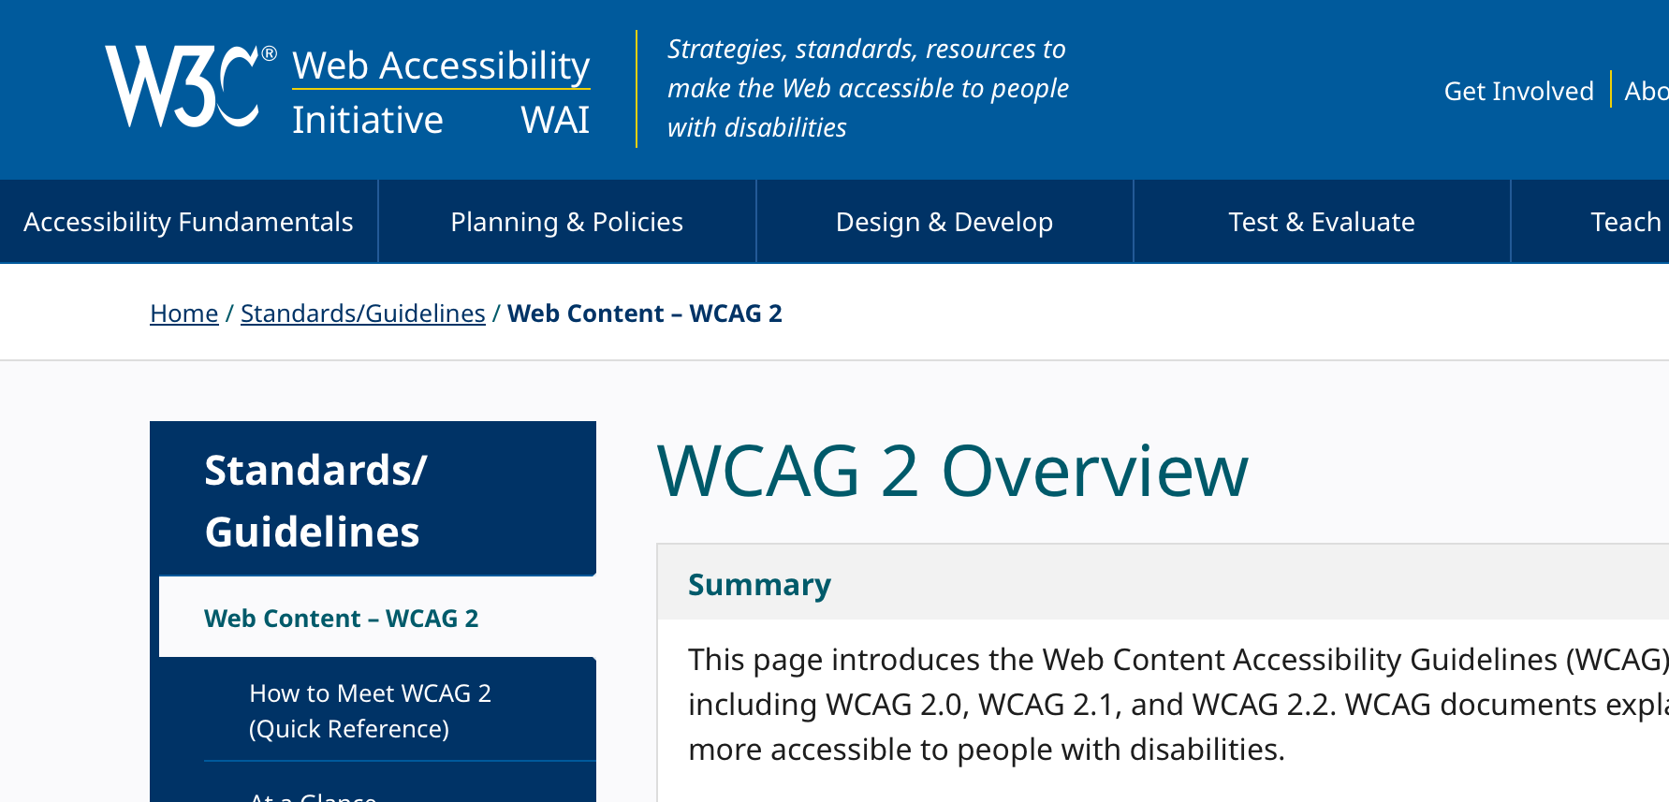
When working in web, there are clear guidelines
Notes:
https://www.w3.org/WAI/standards-guidelines/wcag/

Slide 5
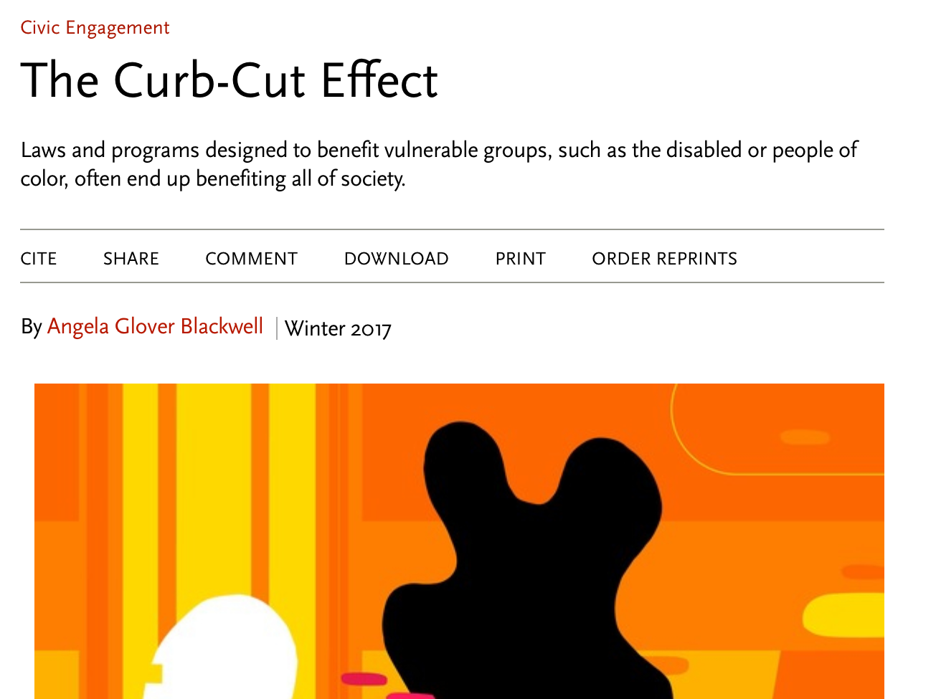
Accessibility is good for everyone
Notes:
https://ssir.org/articles/entry/the_curb_cut_effect

Slide 6
Today
Introduction
> Visual Accessibility
Group Activity
Motor Accessibility
Additional Resources
Notes:
https://webaim.org/standards/wcag/checklist#sc1.4.10

Slide 7



Visual accessibility at a high level
Color Deficiency
Low
Vision
Blind or Partially Blind
May have contrast settings enabled
May use magnifier or scaled resolution
May use screen reader / keyboard only
Notes:
https://thenounproject.com/icon/color-7309833/
https://thenounproject.com/icon/glasses-7656753/
https://thenounproject.com/icon/blind-7616838/

Slide 8
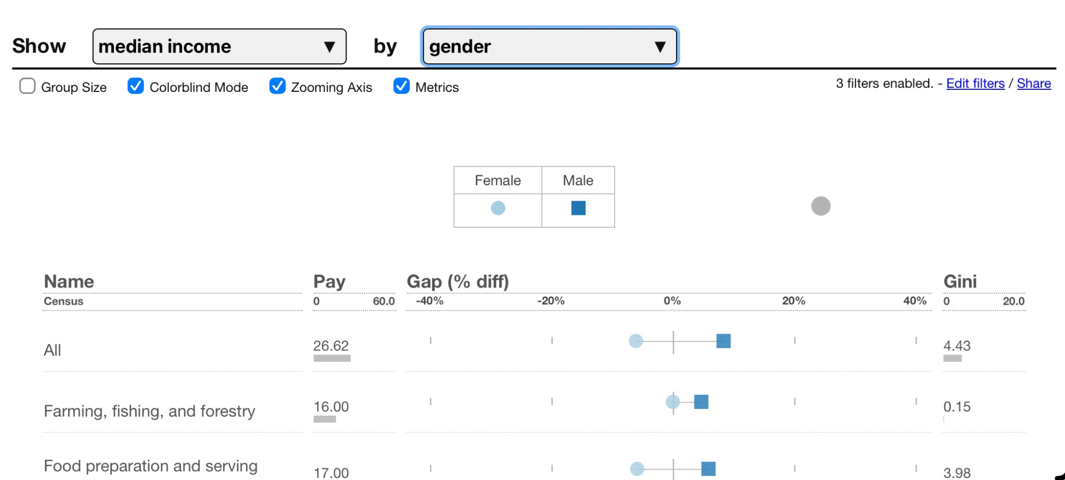
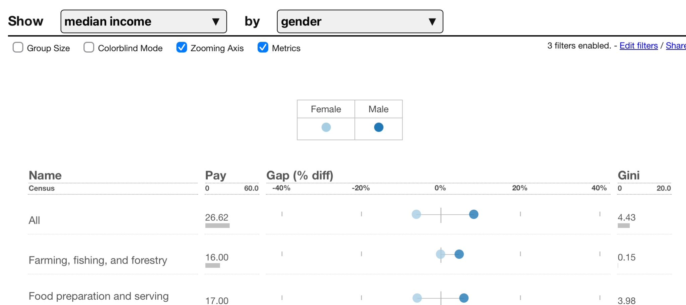
Designing for Color Deficiency (WCAG 1.4.1)
Color should not be the only way that elements are visually distinguished from each other.
This is sometimes called “double encoding” as color is redundant.
Notes:
https://incomegaps.com/

Slide 9
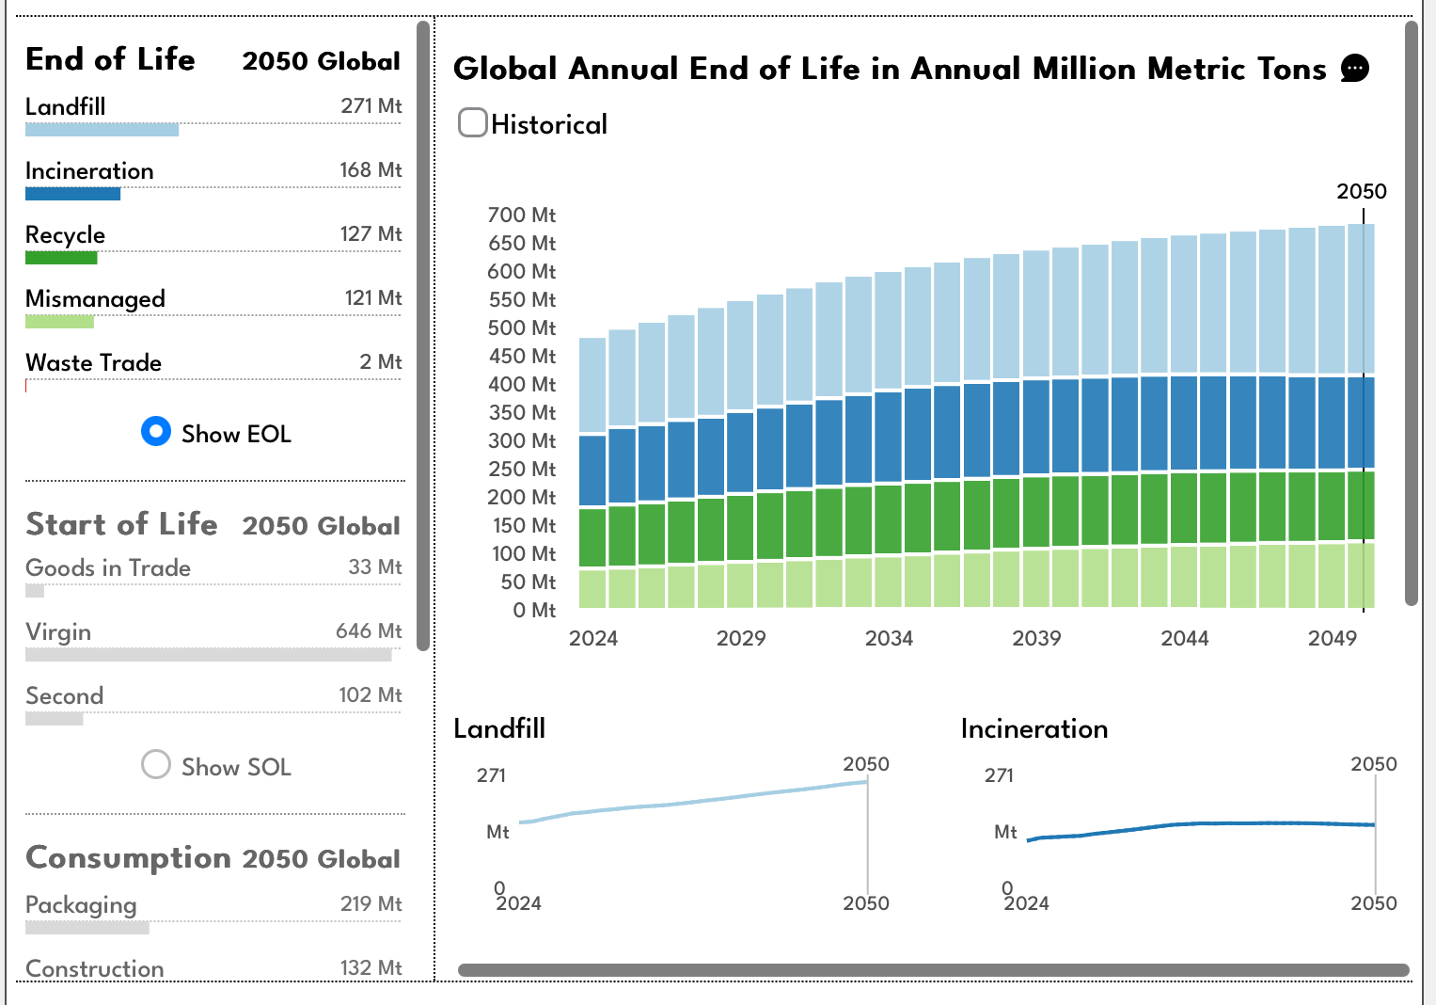
Designing for Color Deficiency (WCAG 1.4.1)
Another option is to offer alternative visualizations.
Be careful with semantic association.

Slide 10
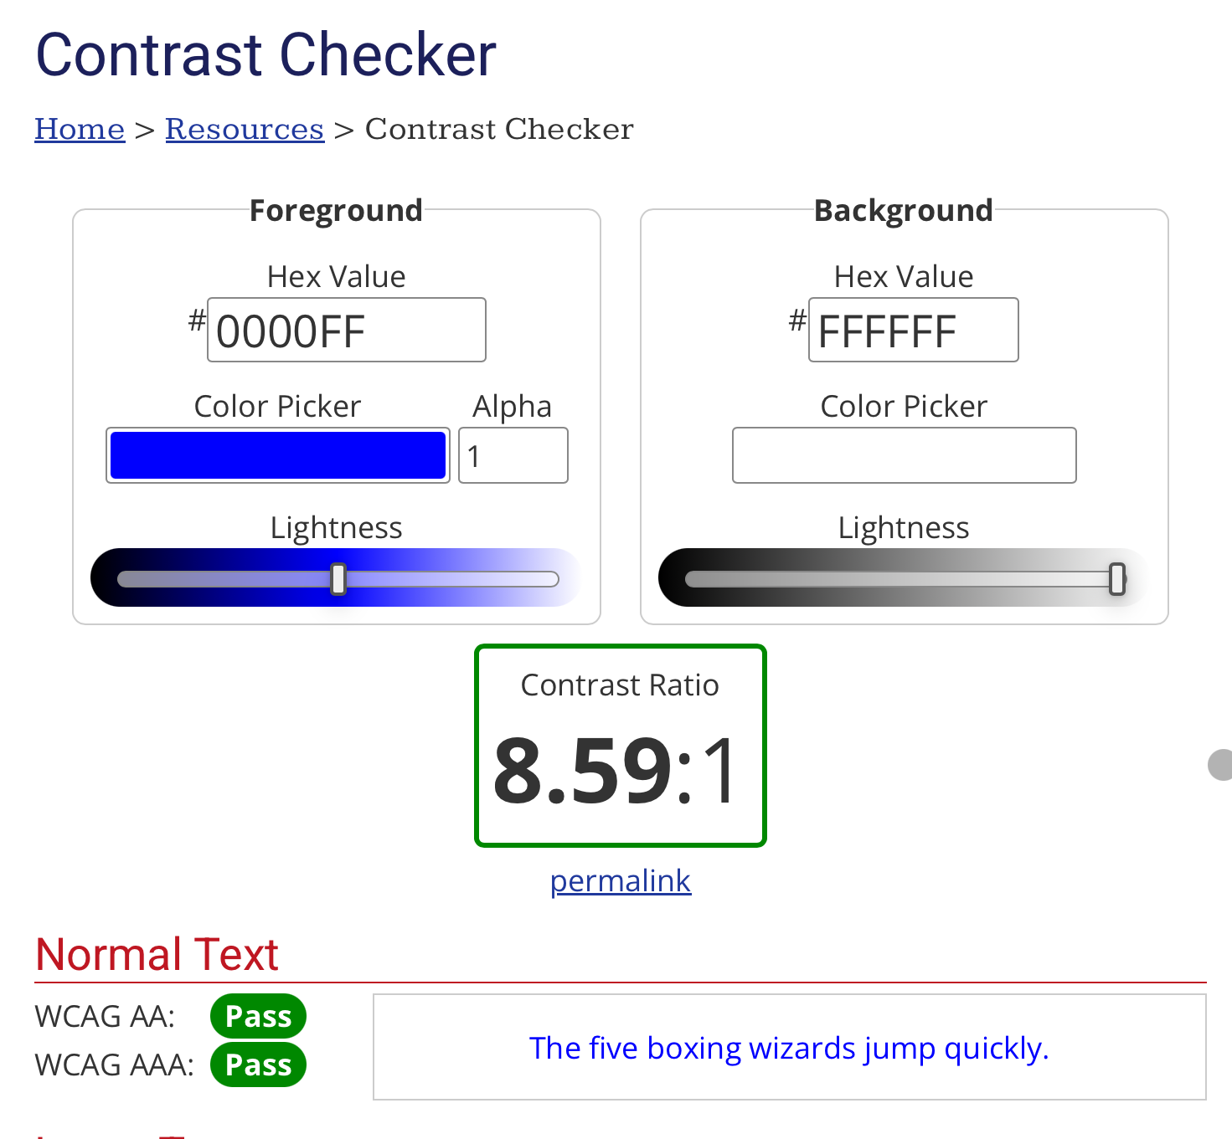
Low Vision: Minimal Contrast (WCAG 1.4.3)
We should ensure that a color is sufficiently different from its background to be perceived.
Also, ensure sufficient contrast between elements as well.

Slide 11
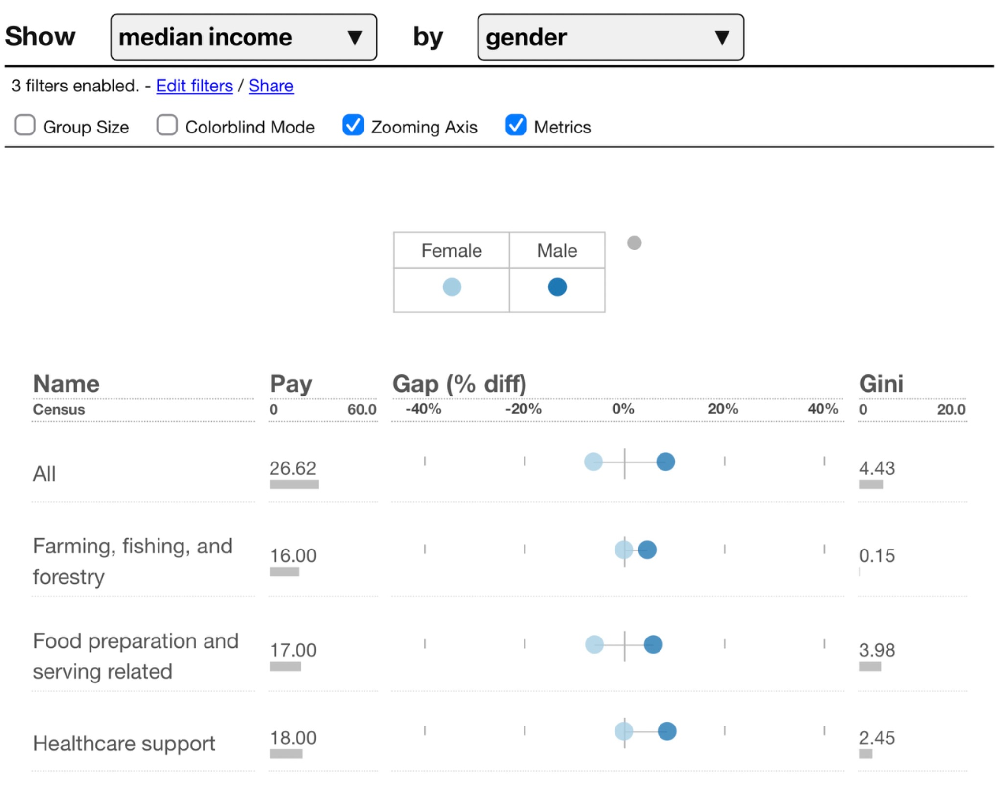
Low Vision: Resize (WCAG 1.4.4)
The application should still work when zoomed to 200%

Slide 12
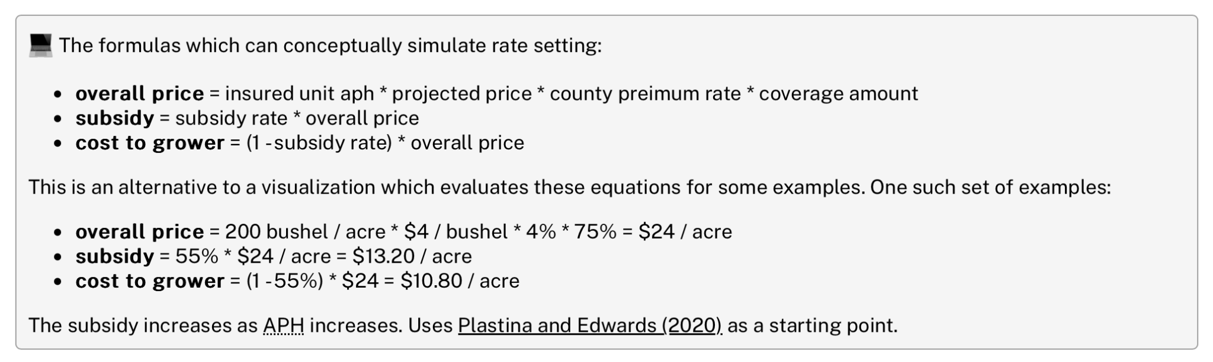
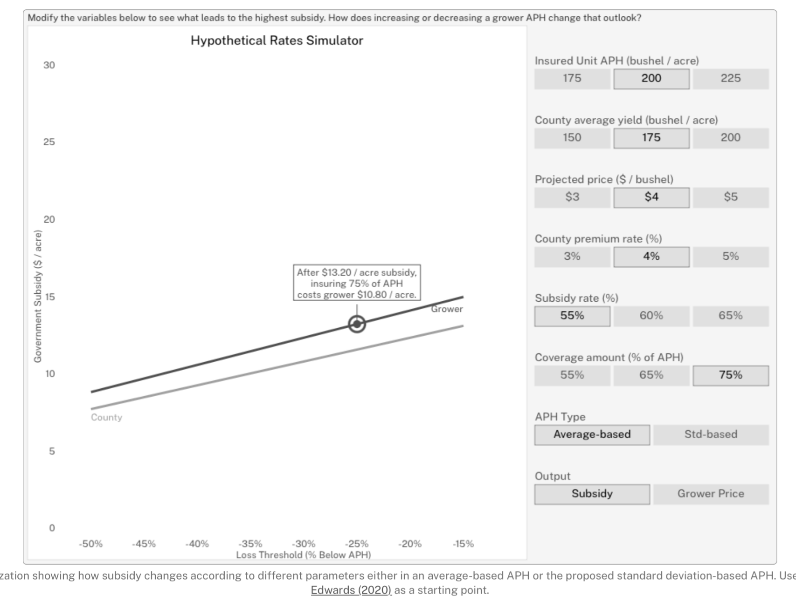
Low Vision: Supporting Screen Readers (WCAG 1.1.1)
Typically this comes in the form of a non-visual alternative such as a table or data download.

Slide 13
Today
Introduction
Visual Accessibility
> Group Activity
Motor Accessibility
Additional Resources

Slide 14
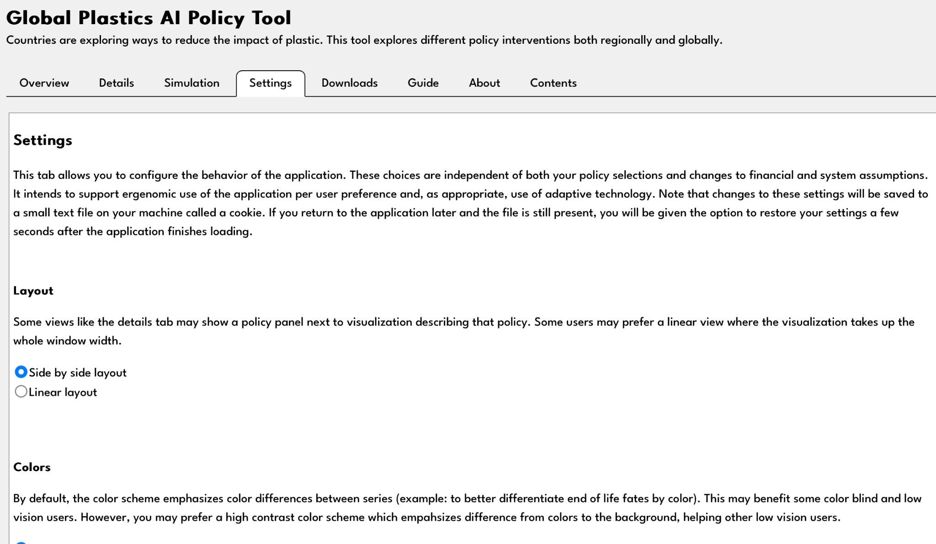
Let’s try some accessibility options
Try out the different accessibility options at:
https://global-plastics-tool.org
What kind of impairment might each option be trying to address?
Notes:
https://global-plastics-tool.org

Slide 15
Today
Introduction
Visual Accessibility
Group Activity
> Motor Accessibility
Additional Resources

Slide 16



Interactive visualization has some motor concerns
Fine Motor Control
May use alternative input devices.
Timed Inputs
May require additional time.
Keyboard-only
May not have a pointing device.
Notes:
https://thenounproject.com/icon/target-4642615/
https://thenounproject.com/icon/keyboard-5600882/
https://thenounproject.com/icon/speed-4573076/

Slide 17
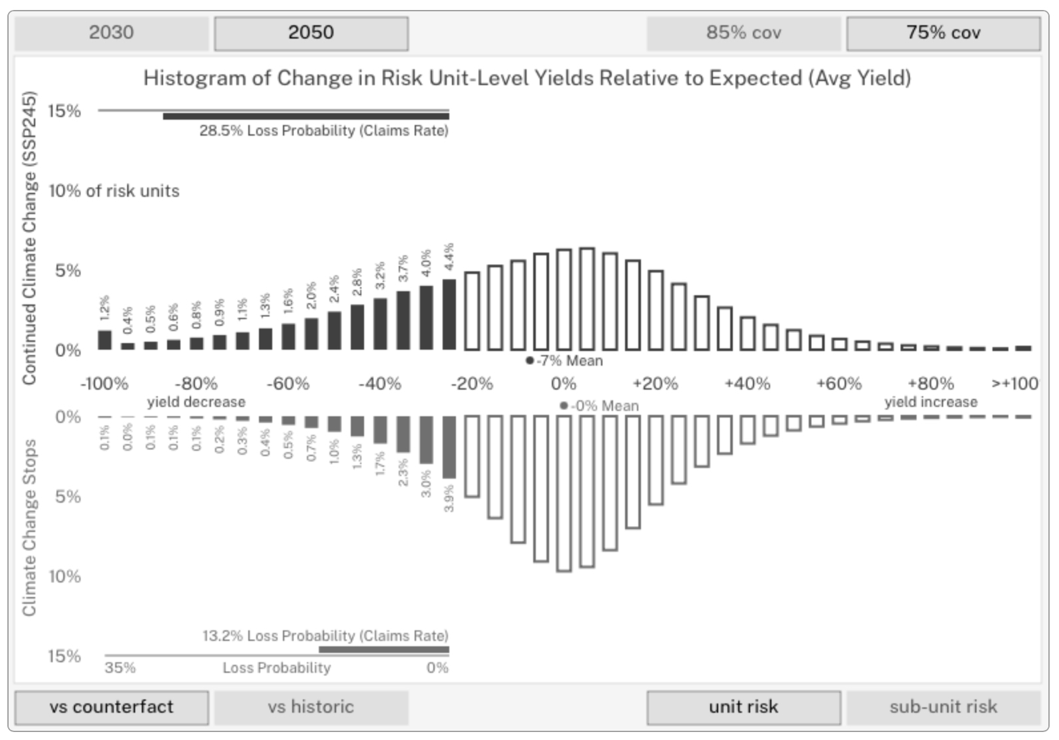
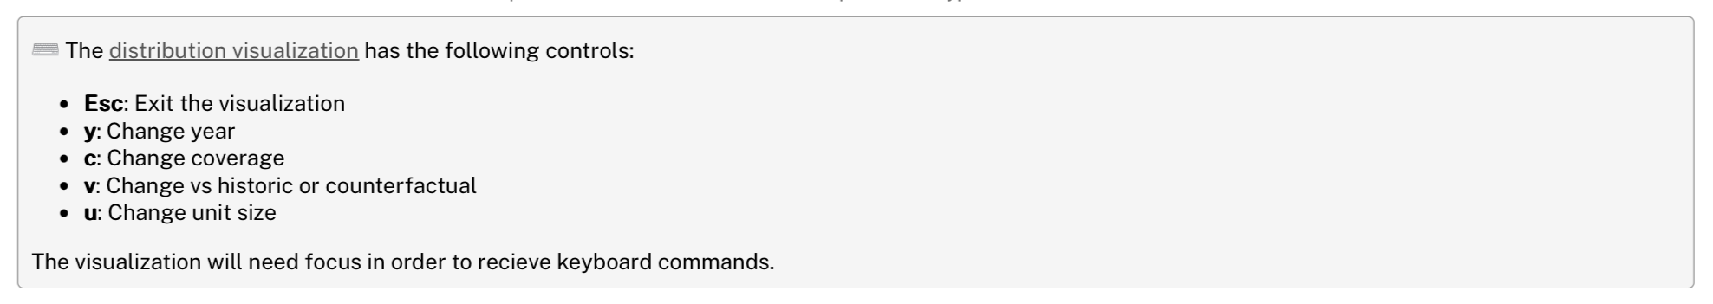
Provide non-keyboard controls (WCAG 2.1.1)
If doing custom drawing, consider adding keyboard alternatives to main controls.
Notes:
https://thenounproject.com/icon/target-4642615/
https://thenounproject.com/icon/keyboard-5600882/
https://thenounproject.com/icon/speed-4573076/

Slide 18
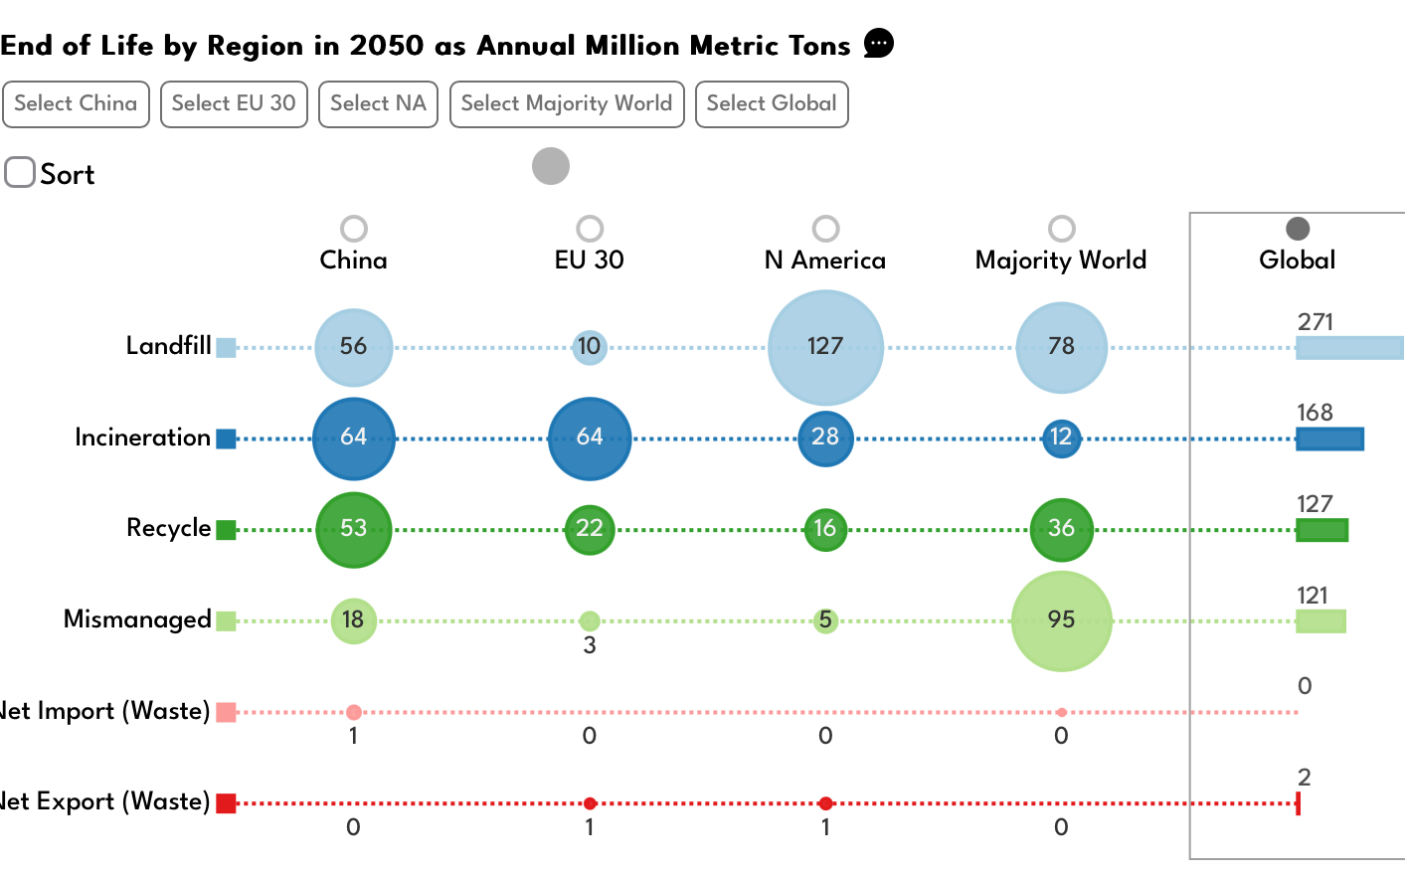
Use tab order and focus (WCAG 1.3.2)
For those using standard HTML elements, consider tab and tab focus.
Notes:
https://thenounproject.com/icon/target-4642615/
https://thenounproject.com/icon/keyboard-5600882/
https://thenounproject.com/icon/speed-4573076/

Slide 19
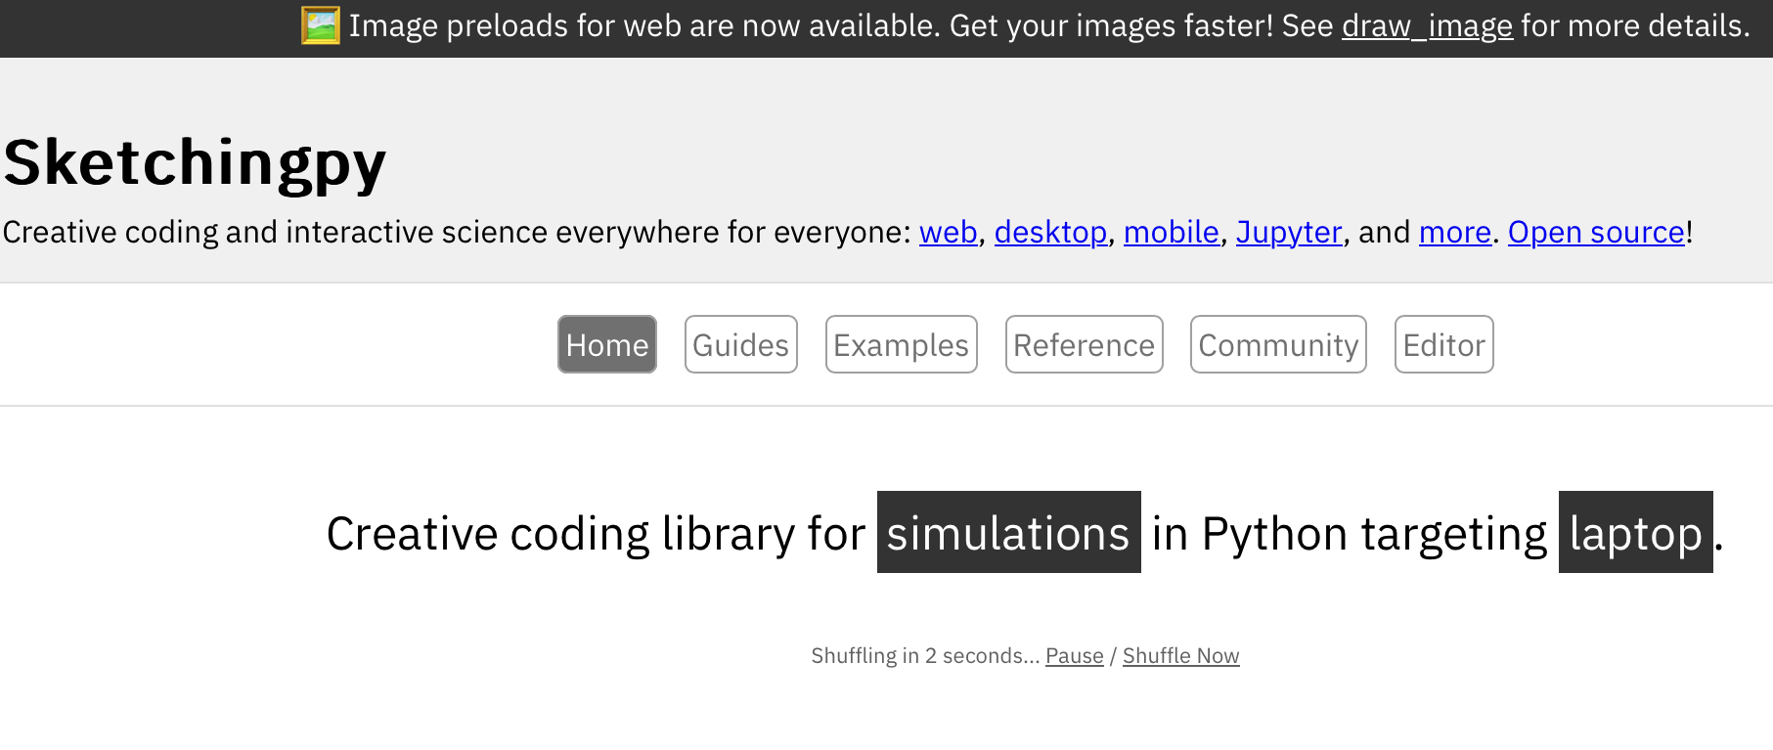
Adjustable timing (WCAG 2.2.1)
Allow modification of timing or pausing of timed actions.
Notes:
https://sketchingpy.org/

Slide 20
Reading
The reading for this lecture will include more info about motor impairment.
Notes:
https://sketchingpy.org/

Slide 21
Today
Introduction
Visual Accessibility
Group Activity
Motor Accessibility
> Additional Resources

Slide 22
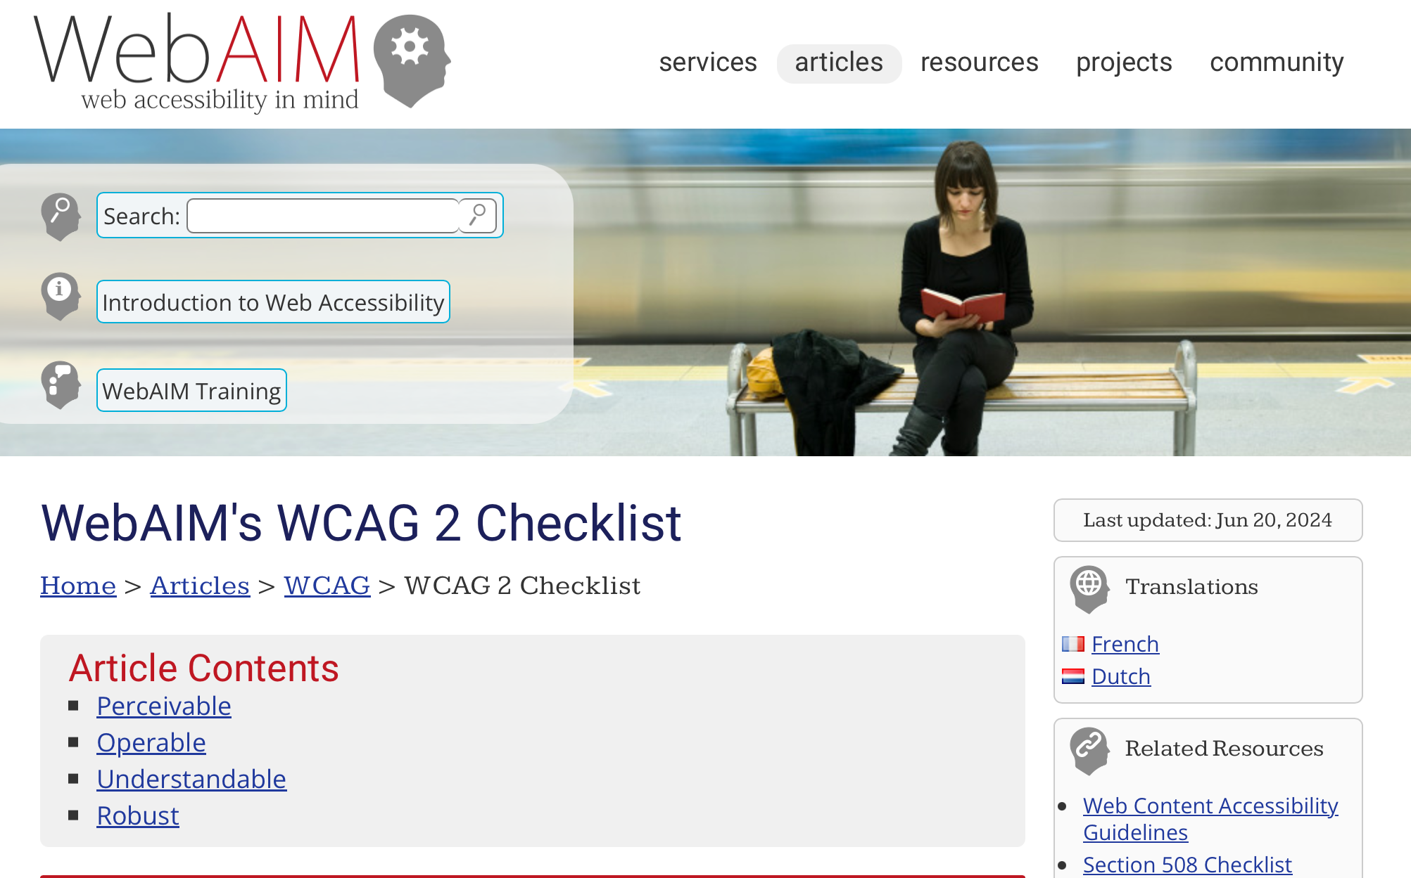
Accessibility is a deep topic
Notes:
https://webaim.org/standards/wcag/checklist

Slide 23
Works cited
A. Shatov, "White Digital Device at 12 00," Unsplash, 2021. Available: https://unsplash.com/photos/white-digital-device-at-12-00-DHl49oyrn7Y
M. Brown, "Making Games Better for Gamers with Colourblindness & Low Vision | Designing for Disability," Game Maker's Toolkit, 2018. Available: https://www.youtube.com/watch?v=xrqdU4cZaLw
WAI, "WCAG 2 Overview," W3C, 2025. Available: https://www.w3.org/WAI/standards-guidelines/wcag/
A. Blackwell, "The Curb-Cut Effect," SSIR, 2017. Available: https://ssir.org/articles/entry/the_curb_cut_effect
Larea, "Color," The Noun Project, 2024. Available: https://thenounproject.com/icon/color-7309833/
Alvida, "Glasses," The Noun Project, 2025. Available: https://thenounproject.com/icon/glasses-7656753/
R. Romadoni, "Blind," The Noun Project, 2025. Available: https://thenounproject.com/icon/blind-7616838/
A. Pottinger, "Income Gaps," Income Gaps Project, 2025. Available: https://incomegaps.com/
A. Pottinger, R. Geyer, N. Biyani, C. Martinez, N. Nathan, M. Morse, M. de Bruyn, C. Boettiger, E. Baker, K. Koy, and D. McCauley, "Global Plastics AI Policy Tool," University of California, 2024. Available: https://global-plastics-tool.org/
A. Pottinger, R. Geyer, N. Biyani, C. Martinez, N. Nathan, M, Morse, C. Liu, S. Hu, M. de Bruyn, C. Boettiger, E. Baker, and D. McCauley, "Pathways to reduce global plastic waste mismanagement and greenhouse gas emissions by 2050," Science, 2024. doi: 10.1126/science.adr3837
WebAIM, "Contrast Checker," Utah State University. Available: https://webaim.org/resources/contrastchecker/
A. Pottinger, L. Connor, B. Guzder-Williams, M. Weltman-Fahs, N. Gondek, and T. Bowles, "Climate-driven doubling of U.S. maize loss probability: Interactive simulation with neural network Monte Carlo," JDSSV, 2025. doi: 10.52933/jdssv.v5i3.134
E. Purnomo, "Target," The Noun Project, 2022. Available: https://thenounproject.com/icon/target-4642615/
P. Octaviani, "Keyboard," The Noun Project, 2023. Available: https://thenounproject.com/icon/keyboard-5600882/
Alzam, "Speed," The Noun Project, 2022. Available: https://thenounproject.com/icon/speed-4573076/
A. Pottinger and Sketchingpy Contributors, "Sketchingpy," Sketchingpy Project, 2025. Available: https://sketchingpy.org/
WebAIM, "WebAIM's WCAG 2 Checklist," Utah State University. Available: https://webaim.org/resources/contrastchecker/

Slide 24
